Slide 1
Prediction and Interpolation using Regression Methods
SHUBHAM SINGH 06278584

Slide 2

Evolution is definable as a change from an incoherent homogeneity to a coherent heterogeneity
- Herbert Spencer

Slide 3

OVERVIEW
1
PREFACE
2
REGRESSION EQUATION
3
STANDARD PROCEDURE
4
PROPOSED METHODOLOGY
5
CASE STUDIES
6
CONTRIBUTION TO SCHLUMBERGER

Slide 4
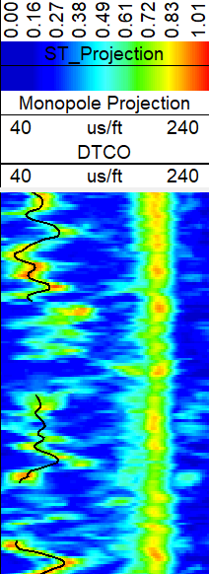
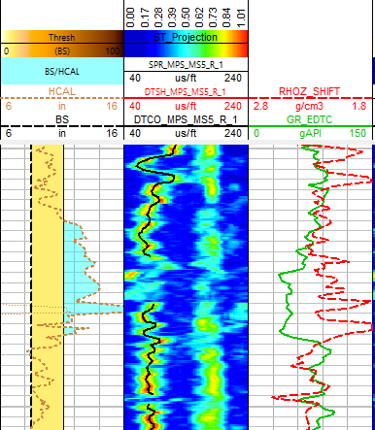
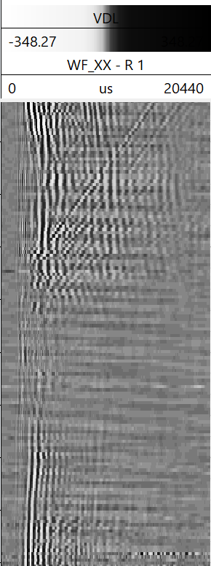
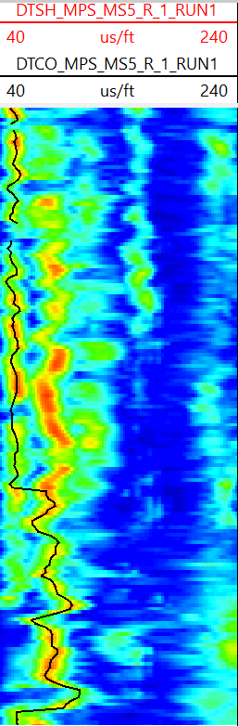
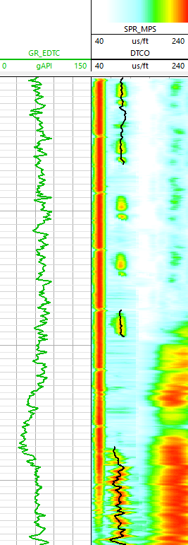
DATA
INFORMATION
PROCESS
ACQUIRE
INTERPRET

Slide 5
DATA
INFORMATION
PROCESS
ACQUIRE
INTERPRET
QUALITY
RELIABILITY
TIME
QUANTITY
1. Poor quality recording
2. Instrument failure
3. Noise, interference of different arrivals
4. Data gaps in various curves
5. Absence of Input Variables
Washouts in region affecting density/porosity curve
Casing arrival interference with fast DTCO/casing flexural with DTSH
Rush hours Processing
Instantaneous change of reference curves
Absence of basic logs
GR based DTCO processing in a few Sonic Vision jobs
Density not available in the run (LWD cases)

Slide 6
DATA
INFORMATION
PROCESS
PETROPHYSICIST
ACQUIRE
INTERPRET
QUALITY
QUANTITY
RELIABILITY
TIME

Slide 7
Regression-based techniques
DATA
INFORMATION
PROCESS
PETROPHYSICIST
ACQUIRE
INTERPRET
QUALITY
QUANTITY
RELIABILITY
TIME

Slide 8
OBJECTIVE
REGRESSION EQUATION
Number of features/input variables present
Prediction, Interpolation , Classification
Correlation between I/O variable
INPUT/OUTPUT VARIABLES
Independency and or consistency between input variables
Algorithm
DATA WRANGLING
Scaling of Data
METRICS
Outlier Removal
ERROR ESTIMATION
Feature Selection/Extraction/Removal
Training Set/Test set/Blind set
RELIABILITY/APLICABIILITY
Variance vs Bias
Overestimation of data

Slide 9
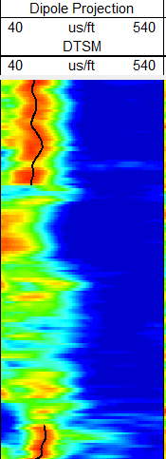

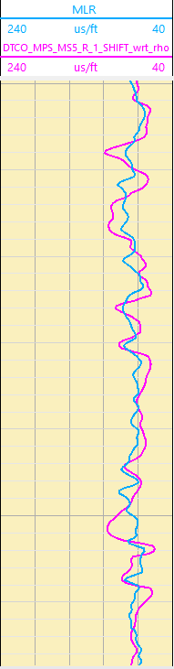
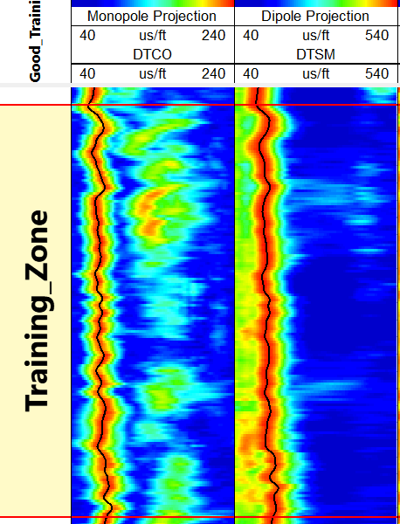
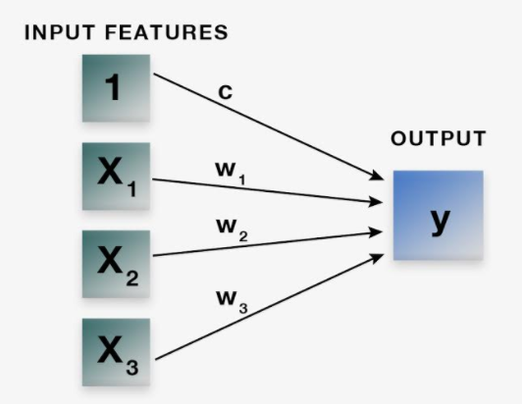
Standard Regression Procedure
Determining the correct Input Variables
Delineating the Objective
Computing the curve and measuring the error
Specifying Training zones based on data quality
Selecting the Algorithm type

Slide 10

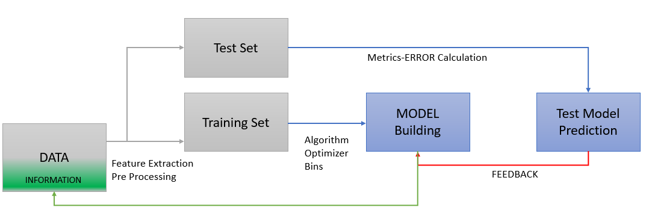
Proposed Regression Procedure
GOOD ZONES
BEST ALGORITHM
OPTIMISED OUTPUT
ERROR MEASUREMENT
UNIFIED FUNCTION
Automated compartmentalization of the data
Mechanized selection of features
Push Button Pre-processing of features
Self-Regulated Metric backed selection of algorithm
Comprehensive error assessment
Optimum Result

Slide 11
CASE STUDIES
UNIVARIATE
MULTIVARIATE
ONE INPUT ONE OUTPUT MODEL
MULTI INPUTS ONE OUTPUT MODEL
incomplete logging, instrument fault/failure and/or poor-quality recordings
Cluster/Classify Zones depending on values of variable
Polynomial/RFR based best fit equation for the ZONE
INTERPOLATION
PREDICTION
LWD Sonic Vision/Scope Projects
UNAVAILABILITY OF DTCO AT SOME DEPTHS (MD value different)
BUSC Iraq GR vs DTCO
CASING ARRIVAL INTERFERENCE
DATA AVAILABLE ONLY FROM ONE RUN
DATASET SPLICING
Petrosud GR vs DTCO
Avoiding Overestimation
ZONING
WASHOUT ZONES
Training vs validation test appraisal
ALGORITHM
RELIABILITY ON DENSITY LOG DECREASES

Slide 12
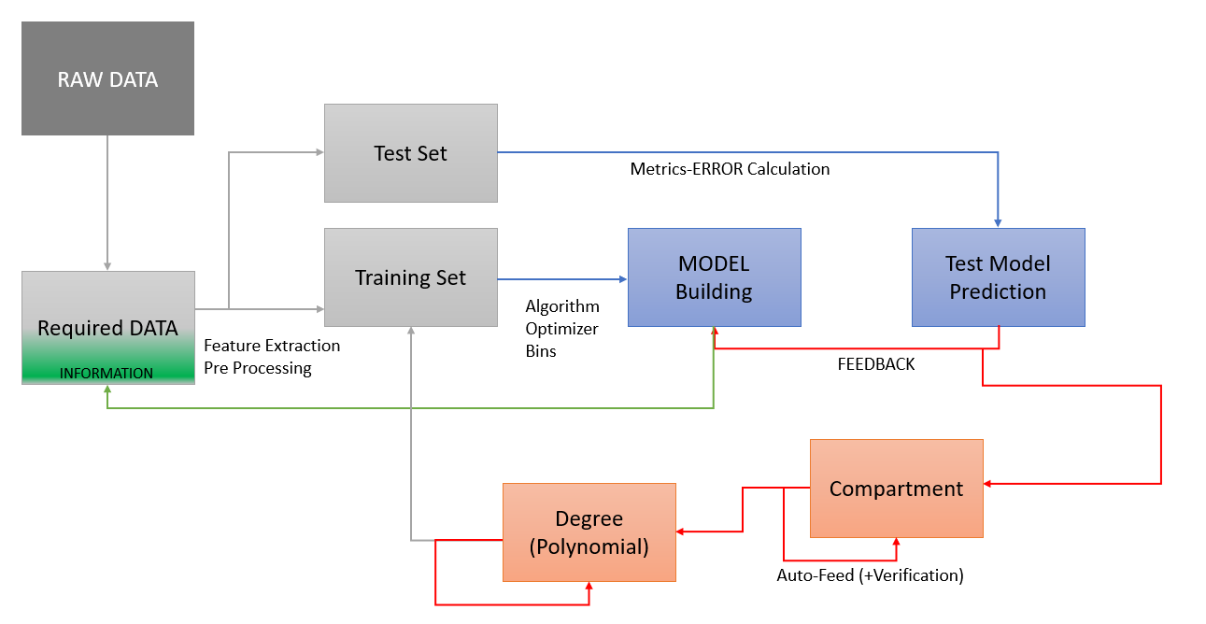
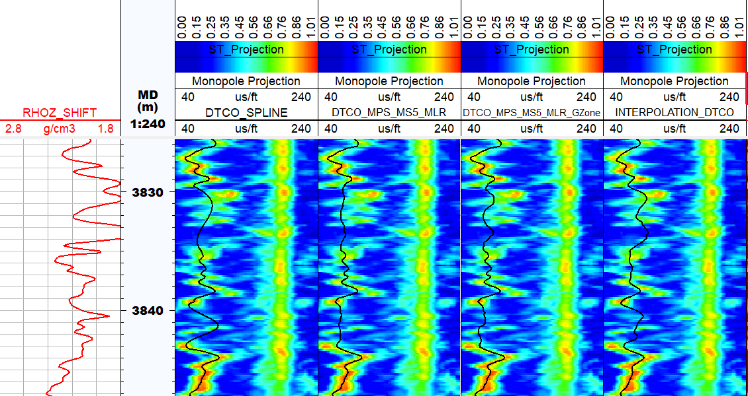
Interpolation using Regression
Splicing of Input and Output Variables
Removal of Outlier, Normalization, Sorting of data
Metric (R/MSE) based Evaluation
Smoothening of data (Choices of filter available)
Eg. In cased hole logs SONIC VISION job INPUT = GR VARIABLE OUTPUT = DTCO VARIABLE
Auto interpolation of Data Gaps

Slide 13
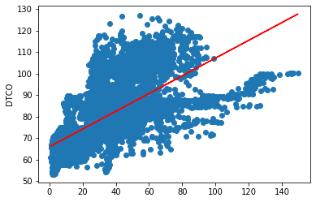
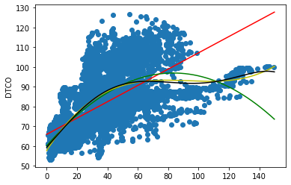
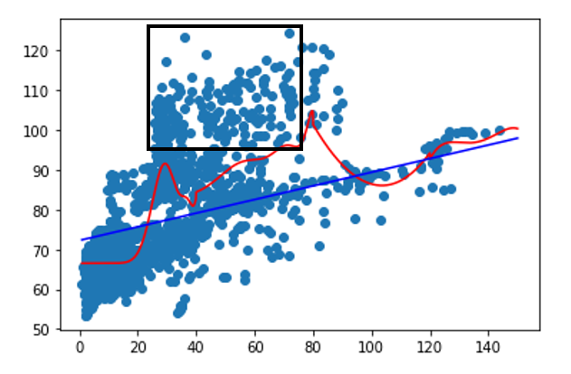
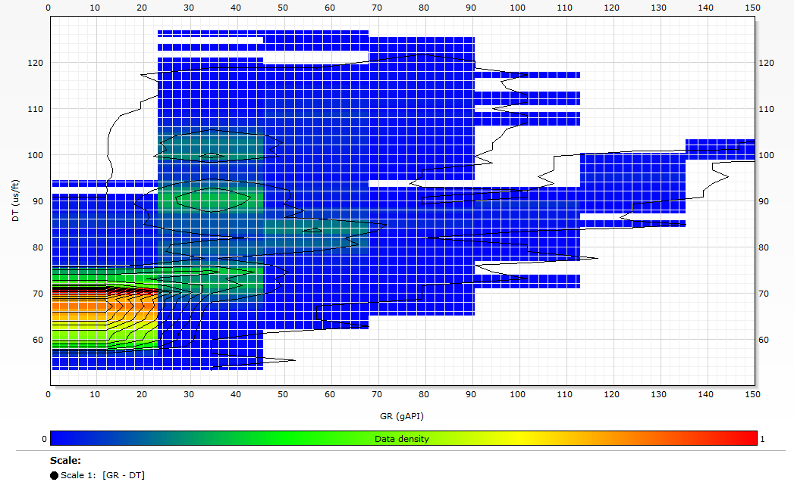
Methodology Stairs
Observed Output
Predicted Output
Linearly predicted DTCO curve overlaid on the scatter plot of GR vs DTCO variables
Different degrees of polynomial regression curves overlay GR vs DTCO scatter plot
Scipy backed Spline interpolation that lead to introduction of discontinuities, not all zone covered properly
Data Density cross plot between GR and DTCO, demonstrating number of readings/datapoints present for different values of GR and DTCO

Slide 14
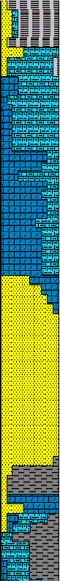
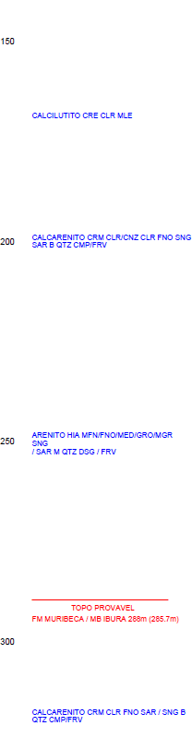
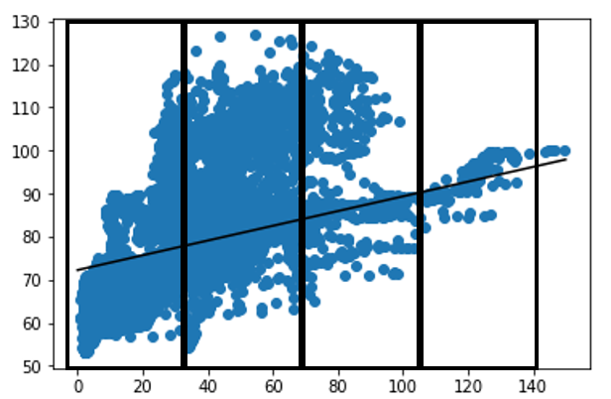

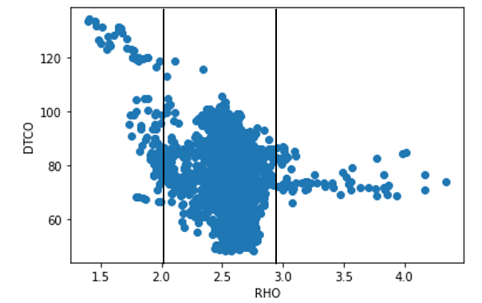
1) Number of compartments 2) Degree of Polynomial Regression 3) Train vs Test Error estimation
1-D Compartmentalization of the dataset
-Overall Trend of the available data
-Type of formation where prediction has to be made -Nature of Input -Density of data points belonging to particular formation type

Slide 15
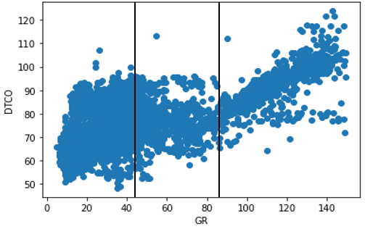
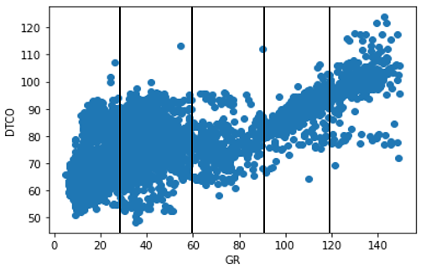
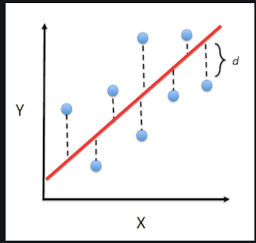
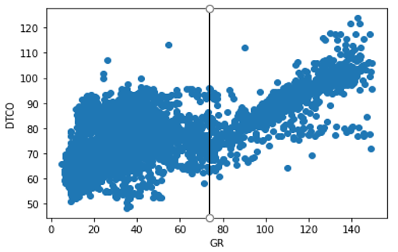
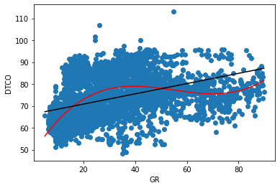
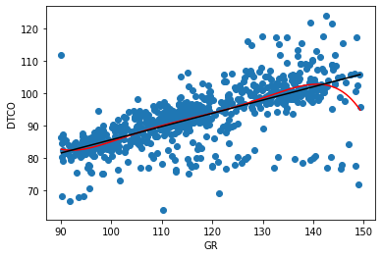
￼
Number of Compartments
METRIC=Mean Squared Error Basis for selection of parameters
Degree of Polynomial

Slide 16
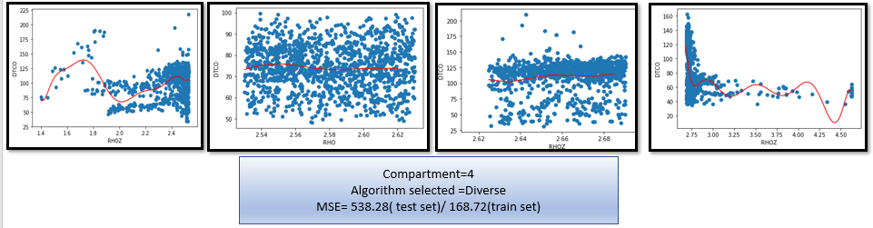
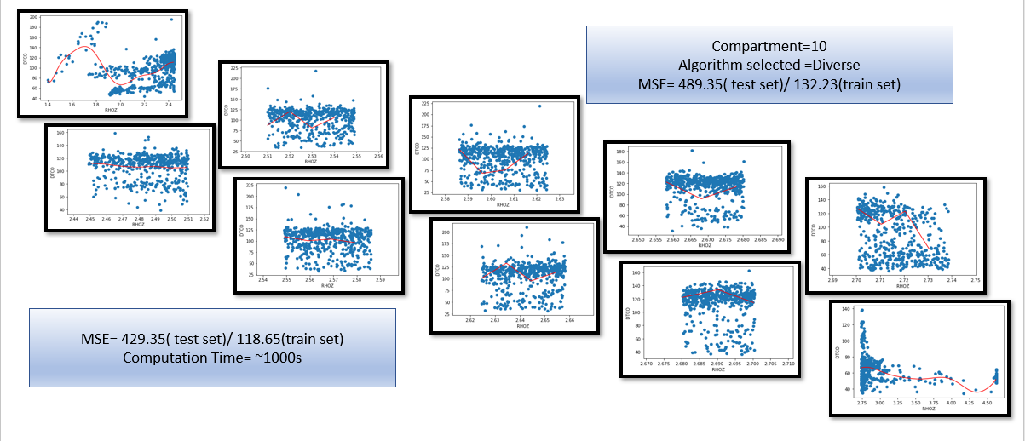
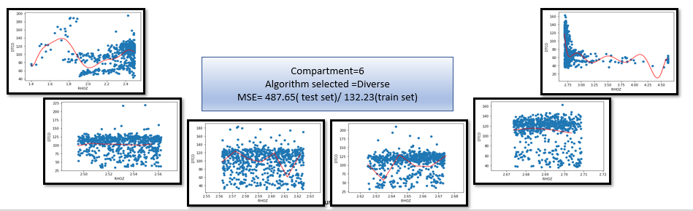

Slide 17
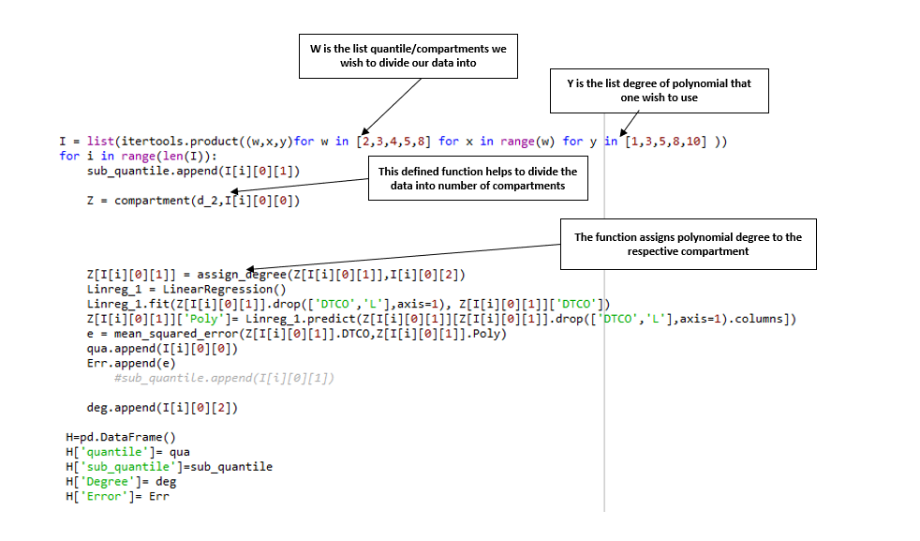
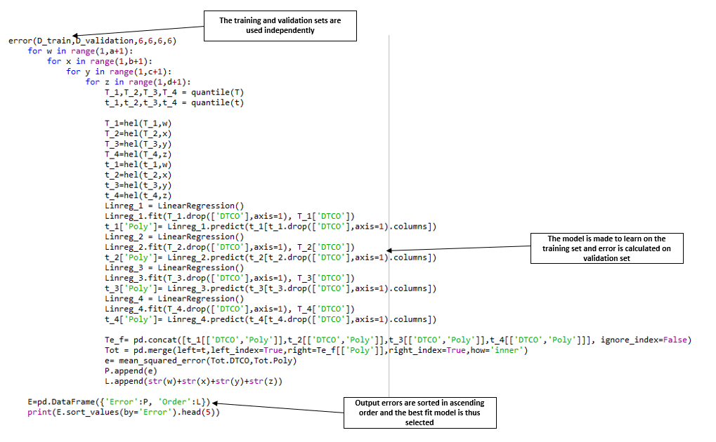
Multi Function backed Compartmentalization and Degree Allocation
List of choices of input variable
List of choices of Compartments
-Sorted values of the variable getting divided into quantiles
List of Degree for equation
Regression variable estimation
Training and Test set MSE error calculation
Prediction Equation

Slide 18
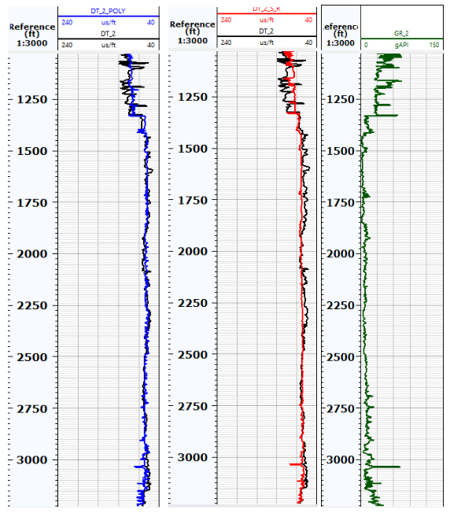
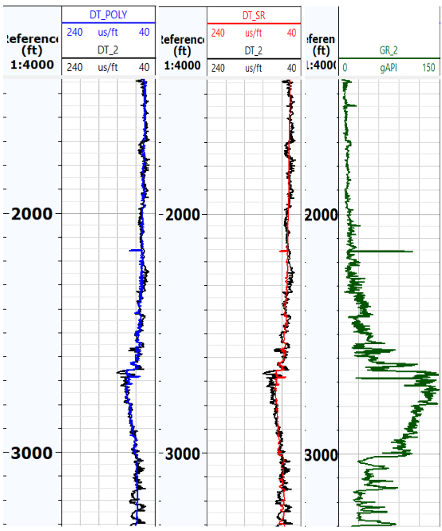
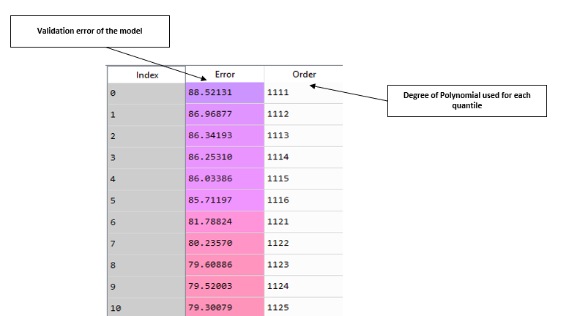
RESULTS
Black = Real logged value of compressional slowness extracted from 15-9-F-11/F_5 volve wells
Blue= Compressional Slowness predicted employing suggested quantile polynomial regression method
Red= Compressional slowness generated using traditional simple regression method
Green= Gamma Ray Log
The table demonstrating the validation error for different order of polynomial used for different compartments in a four-quantile model
Comparison of Original DTCO with the one predicted using simple MLR and the other one using the proposed technique for 15-9-F-11 and 15-9-F-5 well

Slide 19
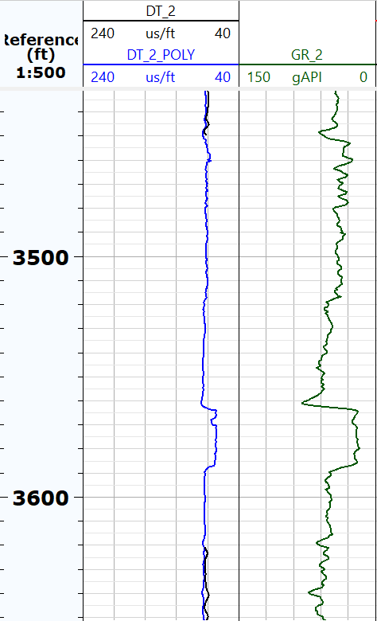
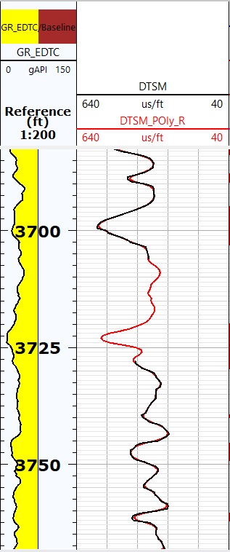
Raw Input Data
Removal of Outlier
Detection of zone of data gaps
Splitting of Training set into Validation and training set
Selection of Zones
Choice of Algorithm
Smoothening of data
The model used to predict the DTCO values in the regions where the real DTCO values were missing for the 15_9_F-11 Well
The model used to predict the DTSM values in the regions where the real DTSM values were missing for the Frontera Energy_ASAI-1 well
Predicted Curve

Slide 20
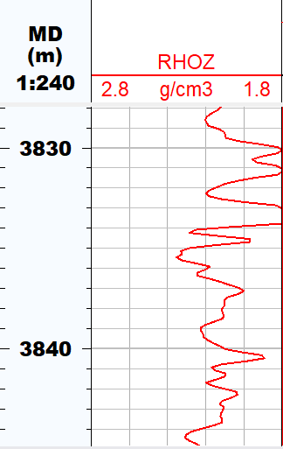
OIL_INDIA _BALIMARA_FIELD
Spline Interpolation
MLR Interpolation with selection of zones with good quality result but different formation type
MLR Interpolation with manual selection of apposite zones
Proposed Algorithm Interpolation
The results obtained from Quantile prediction gives the best result for the data gap region

Slide 21
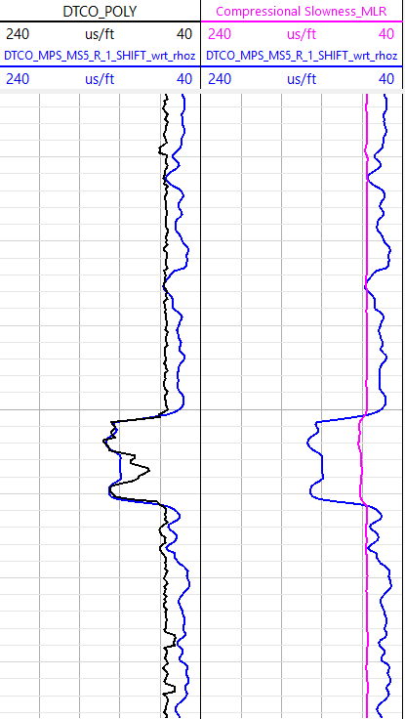
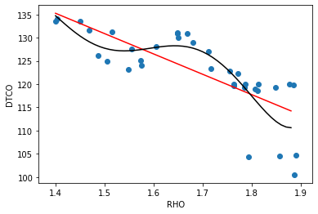
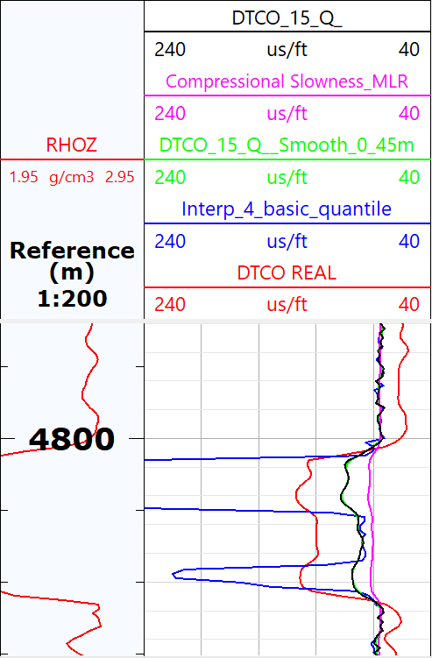
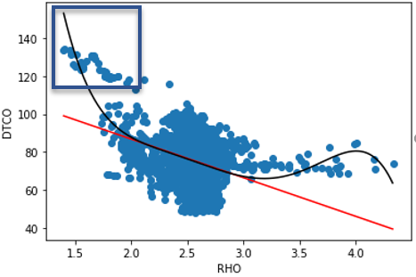
SIGNIFICANCE OF COMPARTMENTALIZATION
Shooting up Effect
ONGC_KGAE WELL

Slide 22
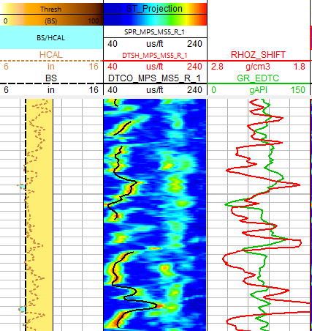
WASHOUT ZONES
Simultaneous 1-D/2-D analysis
Number of input variables to be used is subjected to type of zone
Threshold of Washout needs to be determined prior to analysis
Threshold of Washout
Density not Reliable
Density can be used
GR can be used
Data Gap in Washout Zone
Data Gap in Non-Washout Zone

Slide 23
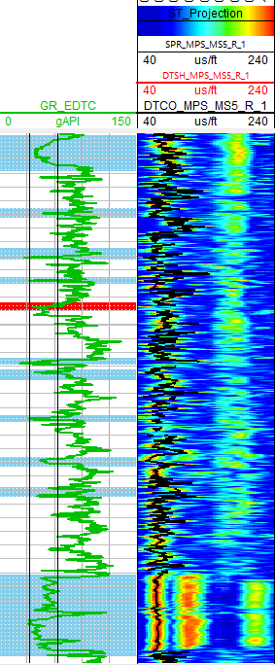
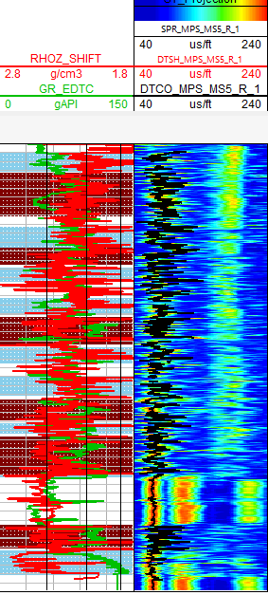
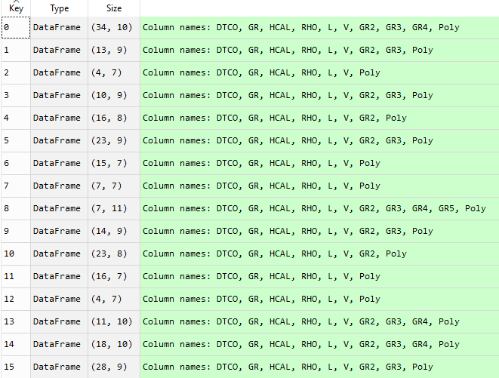
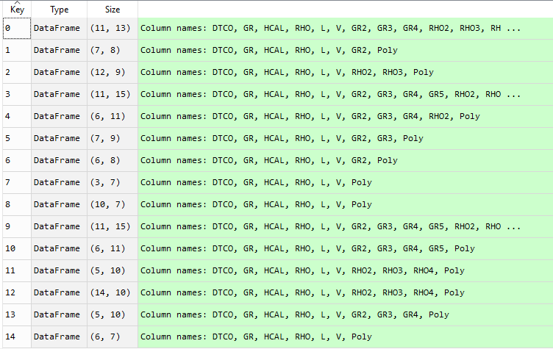
RAW INPUT DATA
Lower Bound of GR
Upper Bound of GR
Distribution of Data gaps into two sub-parts
Using only GR in zones of Washout
Zone where prediction needs to be done
Employing both GR and Rhoz in zones of no washout
Respective 1-D , 2-D zonation of datasets
Determination of degree for each zone
Prediction of DTCO
Smoothening of DTCO
DTCO with filled data gaps

Slide 24
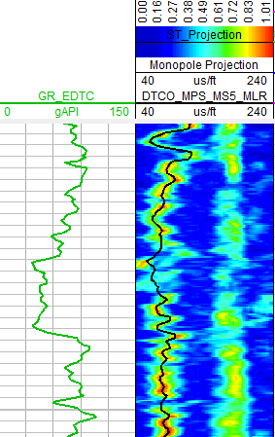
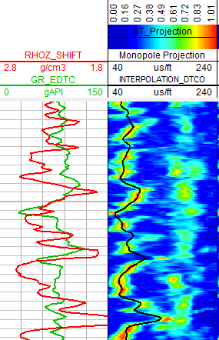
Oil India Balimara Well

Slide 25
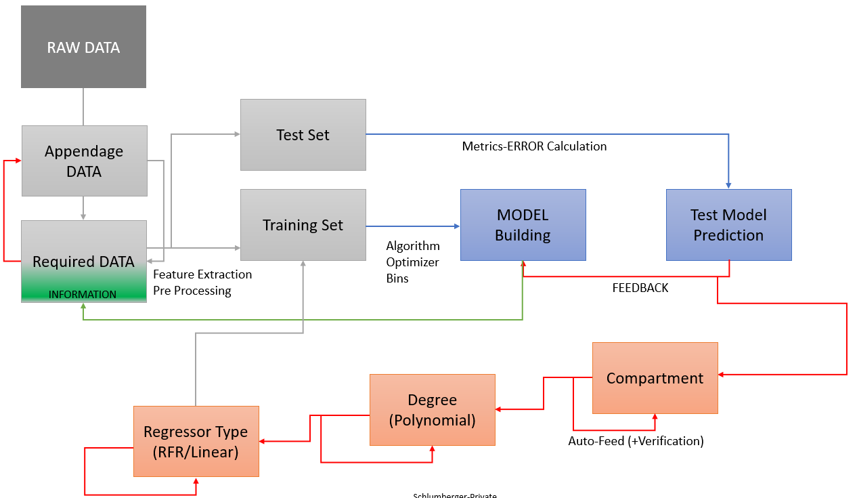
Prediction Using Regression
Empirical Relation for determining output Eg. DTCO from GR at different depths/location
Ensemble/ Bagging based robust RFR technique is introduced to avoid overestimation

Slide 26
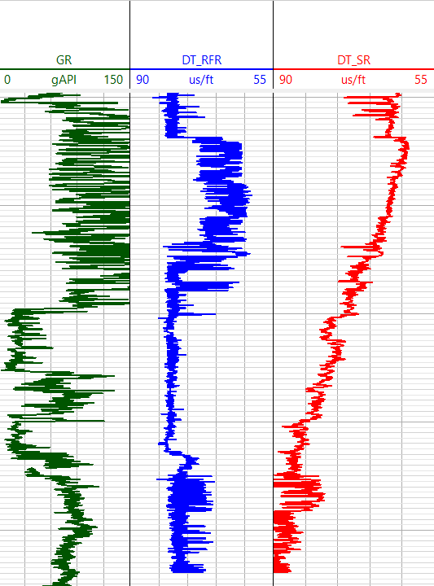
RESULTS
WELL NAME | Input-Output | MSE from Simple Regression | MSE from Proposed Regression | Improvement (Percentage)
 | GR vs DTCO | 115.35 | 71.48 | 38.26%
 | Rho vs DTCO | 200.83 | 108.43 | 46.15%
 | GR vs DTCO | 25.11 | 11.89 | 52.64%
 | DTCO vs DTSH | 92.87 | 81.65 (39.65 for training set) | 11.92%
 | GR vs DTCO | 141.36 | 121.45 (71.48 for some zones) | 14.18%

Slide 27





OXY_Campo_Matanegra-100
GR vs DTCO Prediction Result Training on 15,000 points Testing on 5000 points
Simple MLR without Mud values MSE= 202.31
Poly_quantile_Reg without pre processing MSE= 153.75
Simple MLR with Mud values MSE= 118.4
Poly_quantile_Reg with pre processing MSE= 55.59

Slide 28
MULTIVARIATE APPROACH
Empirical Relation for determining output – MULTIVARIATE Regression
Multiple inputs ( GR, TNPH ) to predict DTCO
Field Empirical relation can be formulated
Classification followed by a regression algorithm is devised
User base input for boundaries of bins
Polynomial regression ( degree of equation based on Standard deviation) is employed
Ensemble based Classifier was appraised (Computation time vs Bias trade off)

Slide 29




SCATTER PLOT OF GR VS TNPH VS DTCO FOR VOLVE F_11 WELL

Slide 30
















0
8
GR
18
36
135
0.05
0.95
0.130
0.21
0.5
TNPH

Slide 31
Number of points
Correlation of each feature with DTCO 3) Degree of Polynomial

Slide 32


Methodology

Slide 33



TRAINING OF EACH ZONE SEPARATELY
ZONING OF TEST SET - Data from a different well of the same field
PREDICTION OF RESULTS

Slide 34
CONTRIBUTION TO SCHLUMBERGER
SIGNIFICANT REDUCTION IN MAN-HOURS
The Pipeline in an automated way helps to pre-process, train and choose the best regression algorithm
The function assess all the zones (bad, good) and formulates optimum training algorithm from them.
Good Quality data – Reduction of at least 0.75-1.5hours
Poor Quality data – Reduction of at least 1.5-2.5hours
FORMULATION OF AN FIELD EMPIRICAL RELATIONSHIP
Provisional-reference variables like DTCO etc can be predicted prior to logging
Self-Executable multi variable dependent prediction algorithm can be devised

Slide 35
WAY Forward
Creation of Techlog Plugin for the algorithm
Incorporation of more features into Pipeline Automated reading of SPR zones, Basics of Depth matching etc., Filtering of noise and spikes
Testing of algorithm for different sets of inputs for other petrophysical jobs
Creation of sequence to sequence multi variate field specific zone based regression equation
Preparing a repository of Empirical solutions simultaneous synchronisation with acoustic plugin

Slide 36
THANK YOU
OPEN for Feedback Appreciate your response

Slide 37
Annexure========

Slide 38

Interpolation using Regression
UNIVARIATE PREDICTION – INHOUSE PREDICTION
Eg. In cased hole logs INPUT = GR VARIABLE OUTPUT = DTCO VARIABLE
Pre-processing step- 1) Normalization of Input variable
2)Removal of Outlier
3) EDA
Feature Engineering- 1) Polynomial forms of GR variable
2) Slope of GR variable
3) Difference in value of GR for various gap periods
Feature Selection- 1) p-Value estimation
2)Correlation based selection

Slide 39
RAW DATA
Test Set
Metrics-ERROR Calculation
Training Set
MODEL Building
Test Model Prediction
Required DATA
Algorithm Optimizer
Bins
Feature Extraction Pre Processing
INFORMATION
FEEDBACK
Compartment
Degree (Polynomial)
Auto-Feed (+Verification)

Slide 40
RAW DATA
Test Set
Appendage DATA
Metrics-ERROR Calculation
Training Set
MODEL Building
Test Model Prediction
Required DATA
Algorithm Optimizer
Bins
Feature Extraction Pre Processing
INFORMATION
FEEDBACK
Compartment
Degree (Polynomial)
Regressor Type (RFR/Linear)
Auto-Feed (+Verification)

Slide 41

RESULTS
The compressional evaluated using the recommended RFR technique is more consistent with the input GR feature than the compressional generated using Simple regression Technique; Thus we suggest to employ our proposed polynomial featuring backed RFR centered empirical relation to predict values of DTCO for wells that are at different depth levels than the training wells

Slide 42
Test Set
Metrics-ERROR Calculation
Training Set
MODEL Building
Test Model Prediction
DATA
Algorithm Optimizer
Bins
Feature Extraction Pre Processing
INFORMATION
FEEDBACK
Compartment
Compartment
Compartment

Slide 43


Slide 44


Methodology

Slide 45
CONTRIBUTION TO SCHLUMBERGER
APPRECIABLE IMPROVEMENT IN THE PREDICTED RESULTS
The Algorithm was tested on 16 different wells ( variety of Input Output combinations) and provided with improved results
SIGNIFICANT REDUCTION IN MAN-HOURS
The Pipeline in an automated way helps to pre-process, train and choose the best regression algorithm
The function assess all the zones (bad, good) and formulates optimum training algorithm from them.
FORMULATION OF AN FIELD EMPIRICAL RELATIONSHIP
Provisional-reference variables like DTCO etc can be predicted prior to logging
Self-Executable multi variable dependent prediction algorithm can be devised

Slide 46




Methodology
Structuring the Algorithm
Grouping and comparing the estimators
Predicting the results
Tabulating the Preliminary results

Slide 47


RESULTS
The compressional evaluated using the recommended RFR technique is more consistent with the input GR feature than the compressional generated using Simple regression Technique; Thus we suggest to employ our proposed polynomial featuring backed RFR centered empirical relation to predict values of DTCO for wells that are at different depth levels than the training wells
Reduction in MSE error for MANTANEGRA DTCO computation from GR data

Slide 48

W is the list quantile/compartments we wish to divide our data into
Y is the list degree of polynomial that one wish to use
This defined function helps to divide the data into number of compartments
The function assigns polynomial degree to the respective compartment

Slide 49
Prediction Using Regression
Empirical Relation for determining output for eg. DTCO from GR
Compaction needs to be taken into consideration Input = GR + MD ( sub-feature) Output= DTCO
Ensemble/ Bagging based robust RFR technique is employed
Itertool based step by step 1-D hyperparameter tuning algorithm is used
Grid Search based simultaneous hyperparameter tuning algorithm is used
Pipeline based iterative computation( model and error) is employed

Slide 50


Simple regression Technique MSE= 800.61(train set)
Compartment=1
Algorithm selected =RFR MSE= 714.21( test set)/ 222.61(train set)

Slide 51









Compartment=4
Algorithm selected =Diverse MSE= 538.28( test set)/ 168.72(train set)
Compartment=6
Algorithm selected =Diverse MSE= 487.65( test set)/ 132.23(train set)

Slide 52










Compartment=10
Algorithm selected =Diverse MSE= 489.35( test set)/ 132.23(train set)
MSE= 429.35( test set)/ 118.65(train set)
Computation Time= ~1000s
Compartments = 15 MSE= 474.2( test set)/ 101.34(train set)
Computation Time= ~1200s
Overestimation of Model
Time constraint

Slide 53

The training and validation sets are used independently
The model is made to learn on the training set and error is calculated on validation set
Output errors are sorted in ascending order and the best fit model is thus selected

Slide 54

Compressional generated from the proposed quantile polynomial regression technique demonstrates more consistency with GR than the consistency displayed by the compressional slowness generated using simple regression equation in the F_5 well
The model used to predict the DTCO values in the regions where the real DTCO values were missing for the 15_9_F-11 Well

Slide 55

Sets of values of hyperparameter assessed simultaneously on an iterative basis
Different orders of Polynomial regression applied
The model is made to learn on the training set and error is calculated on validation set
Pipeline employed to train the model and compute training , test and blind errors

Slide 56

Validation error of the model
Degree of Polynomial used for each quantile

Slide 57
WELL NAME | MSE ERROR | RMSE ERROR | Percentage Improvement over linear Regression Model (MSE Error)
Linear Regression Equation | 198 | 14.07 | -
Simple RFR Equation | 136 | 11.66 | 31.31%
Tuned RFR Model | 92 | 9.59 | 53.53%
This technique was formulated to detect the right hyperparameter values when assessed in combinations (different from one at a time search) also to pick the optimum order of polynomial that must be used. Different values in the form of list attributing to distinct hyperparameters of the random forest regressor (that included number of estimators, maximum depth, minimum sample at split etc.) was supplied to the model. Besides a list of values as an input range for the polynomial features, was also made available. We employed the product based itertool technique in python to tune our regression model and simultaneously to pick the optimum order of polynomial that must be used. We trained our model on training set and simultaneously computed the training, validation and test error ( mse between predicted and true DTCO values) for each model.
Post compilation, the code function returned the user with a dataframe constituting training, validation as well as the test error for different values of hyperparameters and order of polynomial features.
It was observed, that at times, the model may work well on the training as well as validation sets but may fail to provide good results for the test sets. To verify whether the value of the hyperparameter provides with the most apposite results, we plotted (figure 9) the three kinds of error against range of values of a single hyperparameter, keeping all other hyperparameter values as constant. Concludingly, we selected the best sets of values for the hyperparameters of our model, along with the degree of polynomial order that must be used.
This all-inclusive itertool based multi-dimensional approach provided us with better predicted results but the running time of the approach was too long as compared to our first single search technique.
WHY THE HECK IS THIS AGAIN SHOWED UP
YOU SELECTED THE BEST HYPERPARAMETER NOW WHAT ELSE ARE YOU TRYING TO ACCOMPLISH BY THIS

Slide 58
Hyperparameter/Parameter | Value of Parameter
Number of Estimators in RF | 300
Maximum Depth in RFR | 8
Minimum samples at leaf in RFR | 2
Bootstrapping of samples in RFR | True
Degree of Polynomial of GR used | 5

Slide 59
Limitations
Availability of apposite data for certain formation type

Slide 61



Slide 62




